Slide 1
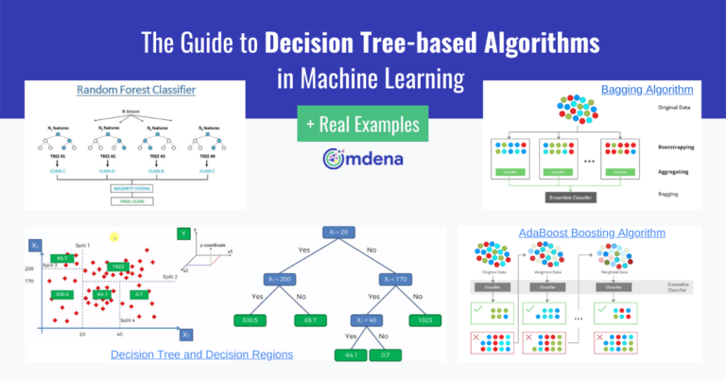
Tree-Based Models (The Visual Logic)
Making Decisions with Flowcharts
Instructor: Zaryab Ahmad Khan

Slide 2
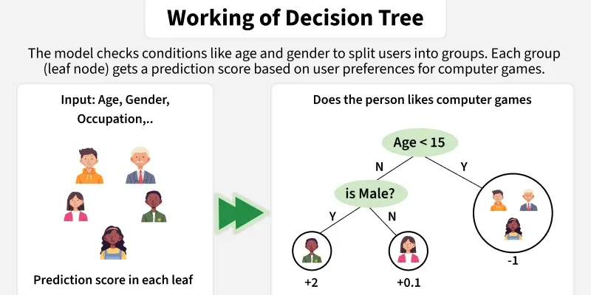
Decision Trees
The Concept: Imagine a game of "20 Questions."
How it works: The algorithm asks a series of If/Else questions to split the data into categories.
Example: "Is the patient's age > 30%" ➔If Yes, "Is their BMI > 25%" ➔ If Yes, "Classify as High Risk.

Slide 3
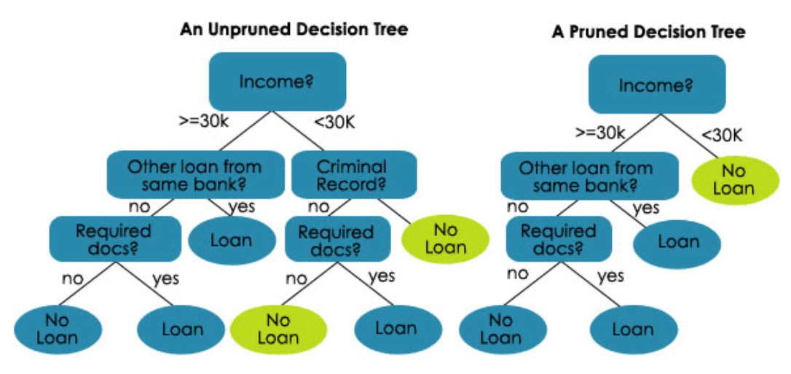
Tree Pruning (Avoiding the Overfit)
The Problem: If a tree is allowed to grow too deep, it will create a "branch" for every single outlier in the data, leading to Overfitting.
The Solution: Pruning.
Method: We set a max_depth (e.g., limit the tree to 3 levels) to keep the logic simple and generalized for the real world.

Slide 4
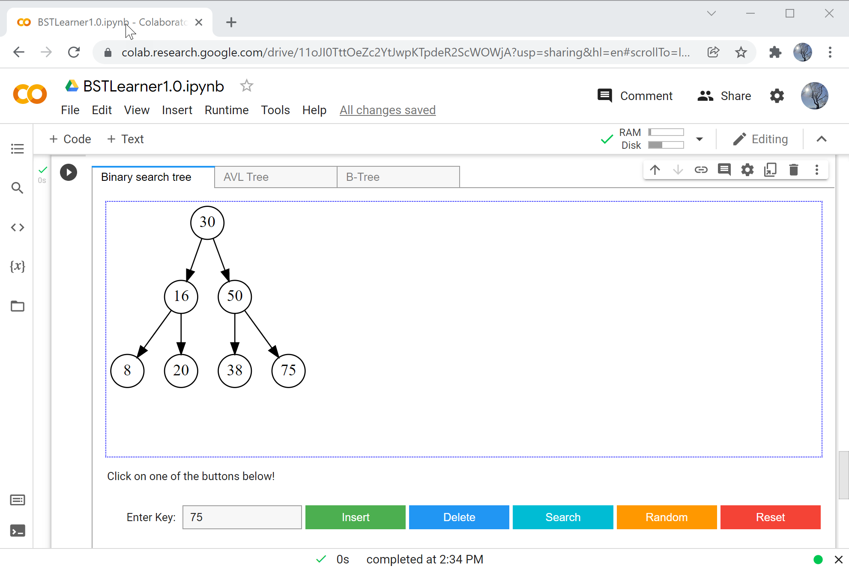
Visualizing the Tree
Transparency: One of the biggest advantages of Decision Trees is that they aren't "Black Boxes."
Interpretation: Using tools in Scikit-Learn, we can export the tree as an image, allowing humans to verify and trust the algorithm's logic.

